Slide 1

Developing the URRA
Sami Durrani PhD and Eric Bergman PhD
Notes:
Quick introductions

Slide 2
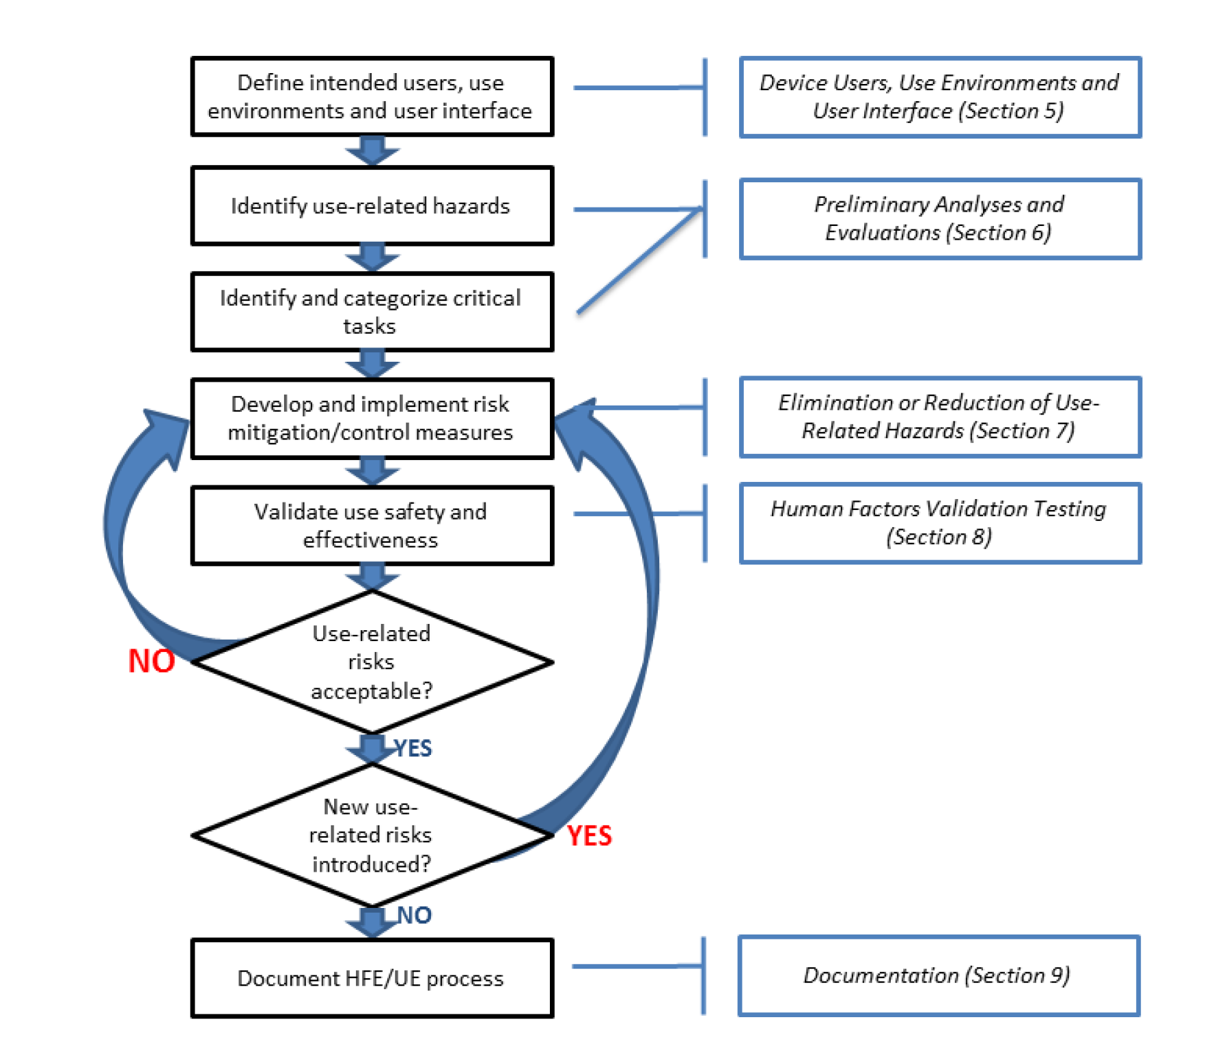
Review: Use-related risk analysis process (as defined by FDA)
Ongoing activity
Notes:
As a reminder the HF process in medical device development is important because medical devices, whether they are simple tools or complex machines, are often used in critical situations where a mistake can have serious consequences. A design that does not consider the user's needs, abilities, and limitations can lead to errors and patient harm.
The overall process in begins by understanding who the users are, their needs, and the environments in which they will use the device, then we conduct an iterative use-related risk analysis. We then design the device, making sure to incorporate human factors principles into the design process to make the UI resistant to use errors (and to also increase usability and user satisfaction). As we design the device we update our use-related risk analysis to match the device design and uncover if any new use related risks have been introduced and we conduct testing along the way to ensure that the designs that we develop are effective in controlling risk.
In other lectures conducting a task analysis to identify potential use errors, as well as how to write good use errors.

Slide 3
Identifying potential use errors?
Potential use errors
Post market surveillance
Known use- problems analysis
Task analysis
HF testing data
Expert and heuristic analyses
FMEAs
Other sources
Notes:
But its also important to note that there are many other sources of use errors that we need to look to conduct a comprehensive use related risk analysis. In this lecture we will work though an example of going through from a task analysis to a URRA document.

Slide 4
Known problems analysis (KPA)
Typical sources of data (not a comprehensive list)
Previous version of device
Similar devices, included competitors
Devices with a similar UI, user interactions, or uses
Post market surveillance data
In-house from your company’s post market surveillance group (typically part of a Quality department)
Customer support department
On-line databases, for example MAUDE
Notes:
A KPA helps identify how people have made mistakes or otherwise struggled using products similar to the one being developed. This can be your own products, a previous version of it, or similar ones you have in the market, or it could be products that competitors might make. Over even a product with just a similar user interfaces, user interactions and/or uses. Online data-sources, such as Manufacturer and User Facility Device Experience (MAUDE). Are a great source of data. Manufacturer and User Facility Device Experience (MAUDE) database represents reports of adverse events involving medical devices.
The searchable database contains the last 10 years of medical device report (MDR) data.

Slide 5
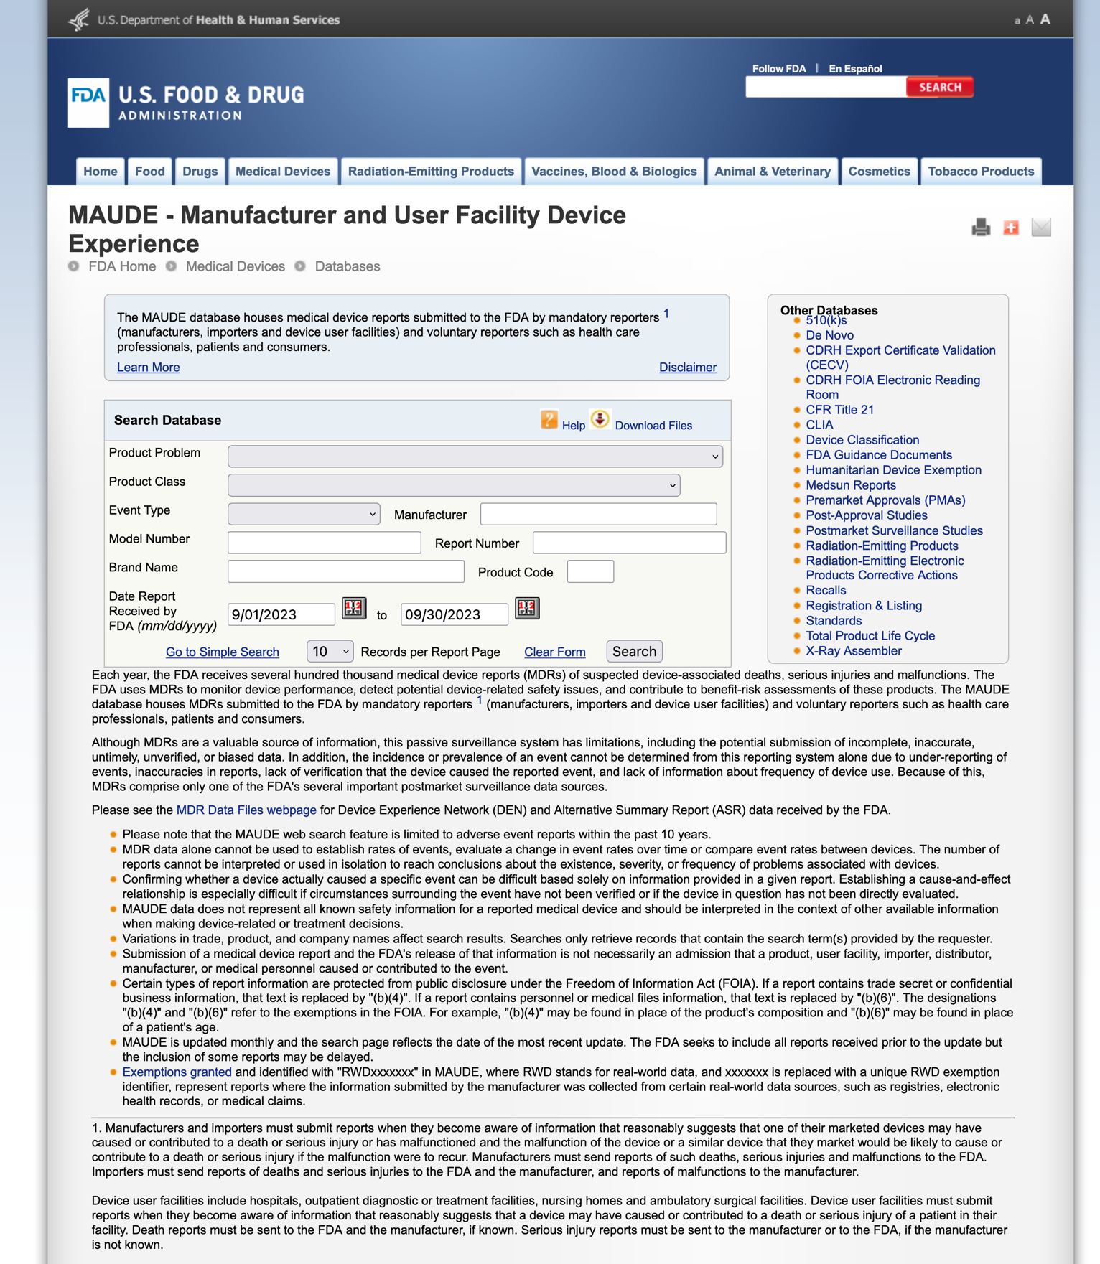
MAUDE
See separate video on conducting a known problems analysis

Slide 6
Recall our EpiPen Auto-Injector (AI) Example
Previously we conducted a Task Analysis…
…Assume now we performed a KPA, Expert Reviews, and Usability Testing and identified the following additional use errors:
User does not dispose of AI in sharps container
User injects with expired drug
User injects with damaged AI
User injects with leaking AI
Now, lets work through our EpiPen example to develop the URRA
Notes:
Important notes to mention:
-The URRA and your task analysis will go through several iterations.
-In practical sense, its easiest to use you task analysis as your draft URRA, add in all your other UEs there and when it comes time to make your final URRA draft, simplify for it for the agency.
When is it time to make your final URRA draft: once we have completed the process, our design is locked, we develop a final draft of our URRA. This final draft becomes the basis of the validation study. I say final draft because if we’ve done our jobs correctly, we shouldn’t expect to see any new use errors and our results should validate that all of our implemented are effective. But that’s not always the case, so you can’t really finalize your URRA until after you have had a successful validation study.

Slide 7
URRA document decomposed
A URRA needs to contain the following:
Reference number
Task description
Potential use errors
Potential hazards and harms
Severity of harm
Critical task (yes or no)
Risk mitigations
Reference to validation of risk mitigation effectiveness
Notes:
As a reminder, here is the structure of a URRA, as requested by the FDA>
When is it time to make your final URRA draft: once we have completed the process, our design is locked, we develop a final draft of our URRA. This final draft becomes the basis of the validation study. I say final draft because if we’ve done our jobs correctly, we shouldn’t expect to see any new use errors and our results should validate that all of our implemented are effective. But that’s not always the case, so you can’t really finalize your URRA until after you have had a successful validation study.

